Slide 1
Python 101
Mico Siahaan

Slide 2
Classes & Objects

Slide 3

Definitions
Class - a template
Method or Message - A defined capability of a class
Field or attribute- A bit of data in a class
Object or Instance - A particular instance of a class

Slide 4

Input
Dictionary
Object
Object
String
Class: An Object Template
Output

Slide 5
Some Python Objects
>>> dir(x)
[ … 'capitalize', 'casefold', 'center', 'count', 'encode', 'endswith', 'expandtabs', 'find', 'format', … 'lower', 'lstrip', 'maketrans', 'partition', 'replace', 'rfind', 'rindex', 'rjust', 'rpartition', 'rsplit', 'rstrip', 'split', 'splitlines', 'startswith', 'strip', 'swapcase', 'title', 'translate', 'upper', 'zfill']
>>> dir(y)
[… 'append', 'clear', 'copy', 'count', 'extend', 'index', 'insert', 'pop', 'remove', 'reverse', 'sort']
>>> dir(z)
[…, 'clear', 'copy', 'fromkeys', 'get', 'items', 'keys', 'pop', 'popitem', 'setdefault', 'update', 'values']
>>> x = 'abc'
>>> type(x)
<class 'str'>
>>> type(2.5)
<class 'float'>
>>> type(2)
<class 'int'>
>>> y = list()
>>> type(y)
<class 'list'>
>>> z = dict()
>>> type(z)
<class 'dict'>

Slide 6
A Sample Class

Slide 7
This is the template for making PartyAnimal objects
class is a reserved word
class PartyAnimal:
x = 0
def party(self) :
self.x = self.x + 1
print("So far",self.x)
an = PartyAnimal()
an.party()
an.party()
an.party()
Each PartyAnimal object has a bit of data
Each PartyAnimal object has a bit of code
Construct a PartyAnimal object and store in an
Tell the an object to run the party() code within it
PartyAnimal.party(an)

Slide 8
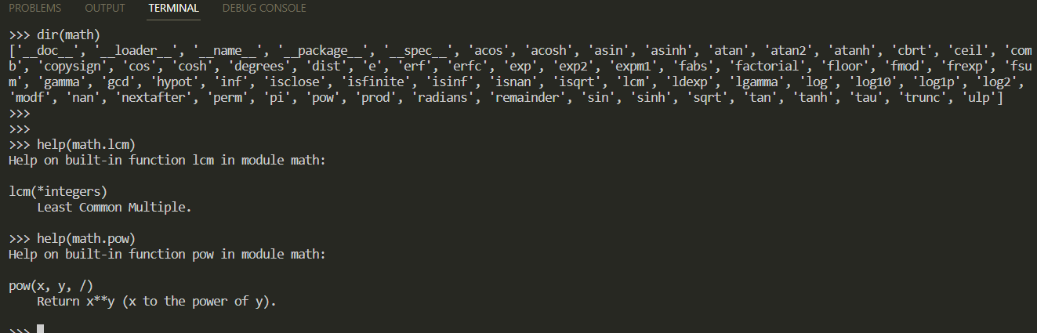
dir() dan help()
dir(): build-in function to check objects and functions/methods lists in an object.
help(): built-in function to read a object’s documentation/help

Slide 9
Inheritance
When we make a new class - we can reuse an existing class and inherit all the capabilities of an existing class and then add our own little bit to make our new class
Another form of store and reuse
Write once - reuse many times
The new class (child) has all the capabilities of the old class (parent) - and then some more

Slide 10
Terminology: Inheritance
‘Subclasses’ are more specialized versions of a class, which inherit attributes and behaviors from their parent classes, and can introduce their own.
http://en.wikipedia.org/wiki/Object-oriented_programming

Slide 11
class PartyAnimal:
x = 0
name = ""
def __init__(self, nam):
self.name = nam
print(self.name,"constructed")
def party(self) :
self.x = self.x + 1
print(self.name,"party count",self.x)
class FootballFan(PartyAnimal):
points = 0
def touchdown(self):
self.points = self.points + 7
self.party()
print(self.name,"points",self.points)
s = PartyAnimal("Sally")
s.party()
j = FootballFan("Jim")
j.party()
j.touchdown()
FootballFan is a class which extends PartyAnimal. It has all the capabilities of PartyAnimal and more.

Slide 12
References
PY4E - Python for Everybody
Invent with Python
The Python Tutorial — Python 3.12.2 documentation
How to Think Like a Computer Scientist — How to Think Like a Computer Scientist: Learning with Python 3 (openbookproject.net)
Python Tutorials – Real Python
Welcome to Python 101! — Python 101 1.0 documentation (pythonlibrary.org)

